Slide 1
AAQ in IT
Why choose IT?
Modular based – Bank unit points as you go
No final exams in summer of Y13
50% of grade comes from coursework
Hands on creation of IT products
Prepares you for work and further educational courses

Slide 2
Course structure
F160 – Exam​ 75glh Fundamentals of Application Development 1.5 - hour exam​ ​ TA1 Types of software used in application design TA2 Software development models TA3 Planning application development projects TA4 Application design scoping TA5 Human computer interface and interaction TA6 Job roles and skills​ |  | F161 - Exam​ 70glh Developing application software 1.5 - hour exam​ ​ TA1 Application software considerations TA2 Data and flow in application software TA3 API (Application Programming Interface) and protocols TA4 Application software security TA5 Operational considerations TA6 Legal considerations
F162– Coursework​ Designing and communicating UI solutions​ 75glh ​ Creation of a prototype App Follow a development lifecycle to plan, develop, test and evaluate a interactive app | F164 - Coursework​ Website development​ 70glh ​ Creation of a website​ Follow a development lifecycle to plan, develop, test and evaluate a website |  | F165 - Coursework​ Immersive technology solution development 70glh ​ Creation of a website​ Follow a development lifecycle to plan, develop, test and evaluate an AR product

Slide 3
Difference between KS4 and KS5 IT course
Two submission dates each year
More time to re-sit any units
Project based coursework again, so you have the grounding knowledge already
Exam units build on what you have already learnt for the exam content in KS4

Slide 4
How to achieve
You will be working on 2 units at a time
You need to dedicate at least 3 hours a week outside of lessons for each of these units
Time management – Create a study timetable to plan when and what you will study, which includes silent study sessions, free lessons and time at home
Pressure will build up if you start to fall behind, so plan from the start how you will manage your time
Exam units | Coursework units
Complete any out of lesson tasks given to you | Complete and submit tasks by the given deadline
Use revision materials given to you, and create your own | Use resources given to check that you have covered everything
Practice exam style questions throughout the learning of each topic | Continue to build coursework products where software is available
Look over learning from the previous lesson before the next lesson

Slide 5
Tasks – F164
P3 – Produce a plan for the website that meets the client’s requirements
You now need to complete the following tasks
Decide on a website to create
Research similar websites and plan content for 6 pages (including the homepage)
Create a site map
Create a storyboard
Decide on the House style
The following slides will guide you through these tasks

Slide 6
Task 1 - Decide on Website
For this unit you will create a Prototype website
Prototype – Partly functional website, shows main content, not including shopping cart
You choose what website to create, linked to outside interests or clubs
Must have a Purpose and Audience
Must have requirements that a fictitious client would need for a purpose
Must have at least 6 pages

Slide 7
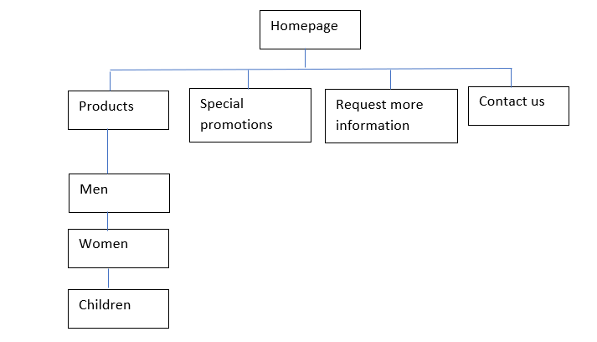
Client requirements
These are likely requirements, depending on your chosen website
Website that sells products/services
  This is the easiest type of website to create, as it has a clear purpose – to sell
  Likely pages include
    Homepage
    Products – showing range of products in images
    Product items – showing details for one product selected (can be several pages)
    Contact details/where to find us
    Special promotions
    Request more information

Slide 8
Client requirements
Interactivity requirements
  At least one video to advertise one/several products/services
  A form for customers to request more info/sign up to newsletter etc
  A slideshow of images – likely to be a range of products
  Interactive navigation – Navigation bar/rollover buttons
Accessibility requirements
  Alt text on all images (including images with text/buttons)
  Contrasting colours
  Links at the bottom of each page
  Change font size feature

Slide 9
Task 2 – Site map
Research a range of websites
From your research choose what website you will create (updated version of a real website or made up company)
Choose a website name
Decide on the 6 pages
Create a site map on Word for your website, showing the name of each page
  Here is an example
  Save it to a New IT folder on your OneDrive

Slide 10
Task 3 – House style
Now you need to create the House style for the company,
House style – Identifies the image of the company
Create a new Word document titled (House style) and create a table like the below example with what you have chosen for each element of the House style
Remember – if you are re-creating an existing company website, you will need to identify and use their house style
Logo | Image of top with “M&W clothing” in top
Background colour/image | Blue Hex:#ECAEAF for background
Font style | Arial
Headings | Cooltext “gold outline” font “Royal Acid Bath” size 24 colour Gold
Main text | Arial black size 12
Slogan | Style to WOW at

Slide 11
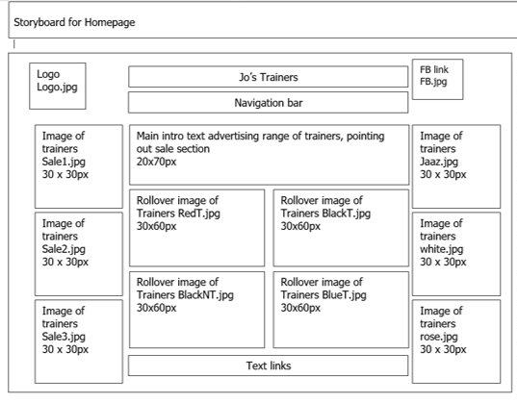
Task 4 - Storyboards
Now you need to create a storyboard (aka wireframe) for each of the 6 pages
Start with the Homepage
This will take time as you need to decide
now what is going on each page, in detail
Use Word again, named “Homepage storyboard”
Place textboxes where each element will go
You need a new storyboard for each page
Write in the textboxes what the element is
Eg Image of blue trainers 30x30px
You will not actually have the images yet but can ]
decide what you want now
You can add the size and filename later
Use the example here as a guide, though you decide the layout and positioning

Slide 12
To bring to 1st lesson
Ensure that you bring the following work (electronic or printed) completed to your first IT lesson with Miss Kirkwood
  Site map for your website
  Storyboards for each of your 6 pages
  House style for your website
We will start learning how to use the software and look at what skills we need to learn

