Slide 1
Notes:
Hello. For those that don’t recognise my voice, I am Mrs Debbage and I am Head of Science. I am here to introduce to you this weeks tutor theme and a national event, British Science Week. This years themes are connections. This can link to a wide variety of topic areas, but we are going to focus on; our connections to the history of science, our connections to the future of science and our connections to the impact of science.

Slide 2
A history of Science…
Notes:
To begin lets watch a quick video summarising some of the major discovers in the history of science. While watching think about the following questions:
Do you recognise any of the scientists in this video?
What did they discover?
Where would we be without these discoveries?

Slide 3
Is science the problem or the solution?
Notes:
We have achieved so much in science, everything from antibiotics to aerosols to the Internet and mobile phones. But developments in science has also had a negative impact on the planet and created weapons and atomic bombs. The question is are scientists and their discoveries responsible for the mess we're in and can science offer a way out? Have a watch of the video and see what you think.

Slide 4
Major Scientific Progress in 2022!
Notes:
Whilst there is a lot to think about from the last video, it can sometimes seem like there is nothing really new in science, but science is always checking and developing and in the last year there has been some major discovers. Explore the next few stories that have featured as headlines in 2022. If something catches you attend links have been included to find out more about them.

Slide 5
The James Webb Space Telescope Arrives at its Destination
What happened: A new space telescope brings promise of exciting findings and beautiful images from the final frontier. This telescope builds on the legacy of its predecessor, the Hubble Space Telescope, which launched over 30 years ago.
Why it matters: The James Webb Space Telescope is our latest state-of-the-art “window” into deep space. With more access to the infrared spectrum, new images, measurements, and observations of outer space will become available.
» To learn more, read this article from The Planetary Society, or watch this video from the Wall Street Journal.

Slide 6
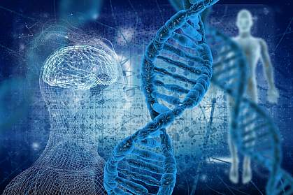
Complete: The Human Genome
What happened: Scientists finish sequencing the human genome.
Why it matters: A complete human genome allows researchers to better understand the genetic basis of human traits and diseases. New therapies and treatments are likely to arise from this development.
» To learn more, watch this video by Two Minute Papers, or read this article from NIH

Slide 7
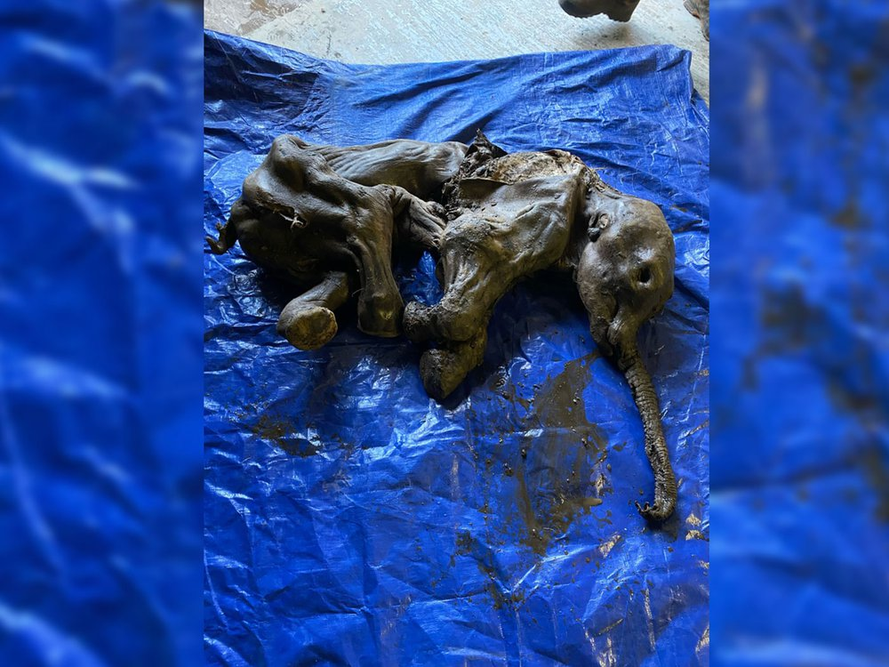
A Perfectly Preserved Woolly Mammoth
What happened: Gold miners unearth a 35,000 year old, well-preserved baby woolly mammoth in the Yukon tundra.
Why it matters: The mammoth, named Nun cho ga by the Tr’ondëk Hwëch’in First Nation, is the most complete specimen discovered in North America to date. Each new discovery allows paleontologists to broaden our knowledge of biodiversity and how life changes over time.
» To learn more, read this article from Smithsonian Magazine

Slide 8
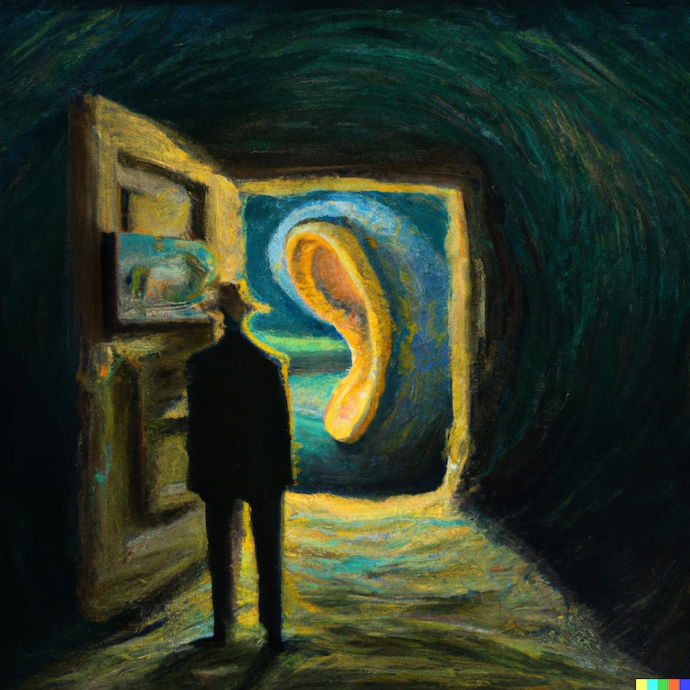
The Rise of AI Art
What happened: Access to new computer programs, such as DALL-E and Midjourney, give members of the general public the ability to create images from text-prompts.
Why it matters: Widespread access to generative AI tools fuels inspiration—and controversy. Concern for artist rights and copyright violations grow as these programs potentially threaten to diminish creative labor.
» To learn more, read this article by MyModernMet, or watch this video by Cleo Abram.

Slide 9
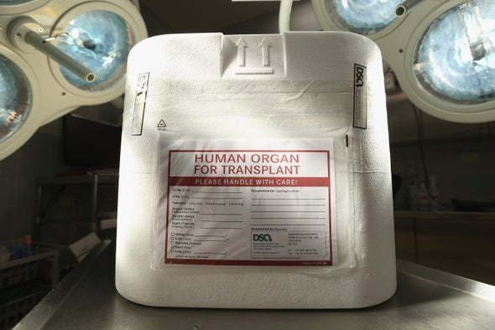
Dead Organs Get a Second Chance
What happened: Researchers create a perfusion system that can revitalize organs after cellular death. Using a special mixture of blood and nutrients, organs of a dead pig can be sustained after death—and in some cases, even promote cellular repair.
Why it matters: This discovery could potentially lead to a greater shelf-life and supply of organs for transplant.
» To learn more, read this article by Scientific American, or this article from the New York Times

Slide 10
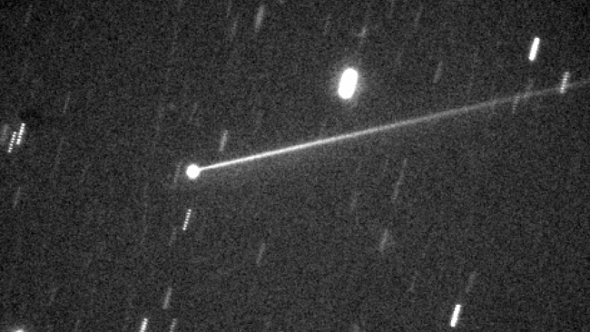
DART Delivers A Cosmic Nudge
What happened: NASA crashes a spacecraft into an asteroid just to see how much it would move. Dimorphos, a moonlet orbiting a larger asteroid called Didymos 6.8 million miles (11 million km) from Earth, is struck by the DART (Double Asteroid Redirection Test) spacecraft. NASA estimates that as much as 22 million pounds (10 million kg) was ejected after the impact.
Why it matters: Earth is constantly at risk of being struck by stray asteroids. Developing reliable methods of deflecting near-Earth objects could save us from meeting the same fate as the dinosaurs.
» To learn more, watch this video by Real Engineering, or read this article from Space.com

Slide 11
Question to consider…
What has been the most important scientific discovery?
How much is there left to discover?
How far should Science go? (genetic engineering, designer babies?)
The UK government is cutting public spending. Should this include cutting the money given to Science research institutes? Should we increase the money we invest in Science?
Notes:
Finally, here are some questions to discuss or take away with you. If you have time there is a mini science quiz you can have a go at.
Thank you for listening and remember science is the future.

Slide 12
Time for a Quiz!

Slide 13
1). In 1953, two scientists announced their discover of Deoxyribonucleic Acid. What is this more commonly known as?
Bonus point: Can you name the two scientists?!

Slide 14
2). What is the name of the female scientist who discovered the radioactive element Radium, and won 2 Nobel Prizes for her work?
Clue: She has a charity named after her.

Slide 15
3). Tim Peake is almost halfway through his stay in Space, where he’s conducting lots of science experiments.
Where is he living during his mission?

Slide 16
4). Which virus is spread between people by the Aedes species of mosquito?
It has been linked to causing brain defects in babies born to infected mothers.

Slide 17
5). Scientists have recently discovered a new species of dinosaur, the Timurlengia euotica, which was about the size of a horse.
They believe this is the cousin of which famous dinosaur?

Slide 18
Time for some Answers!

Slide 19
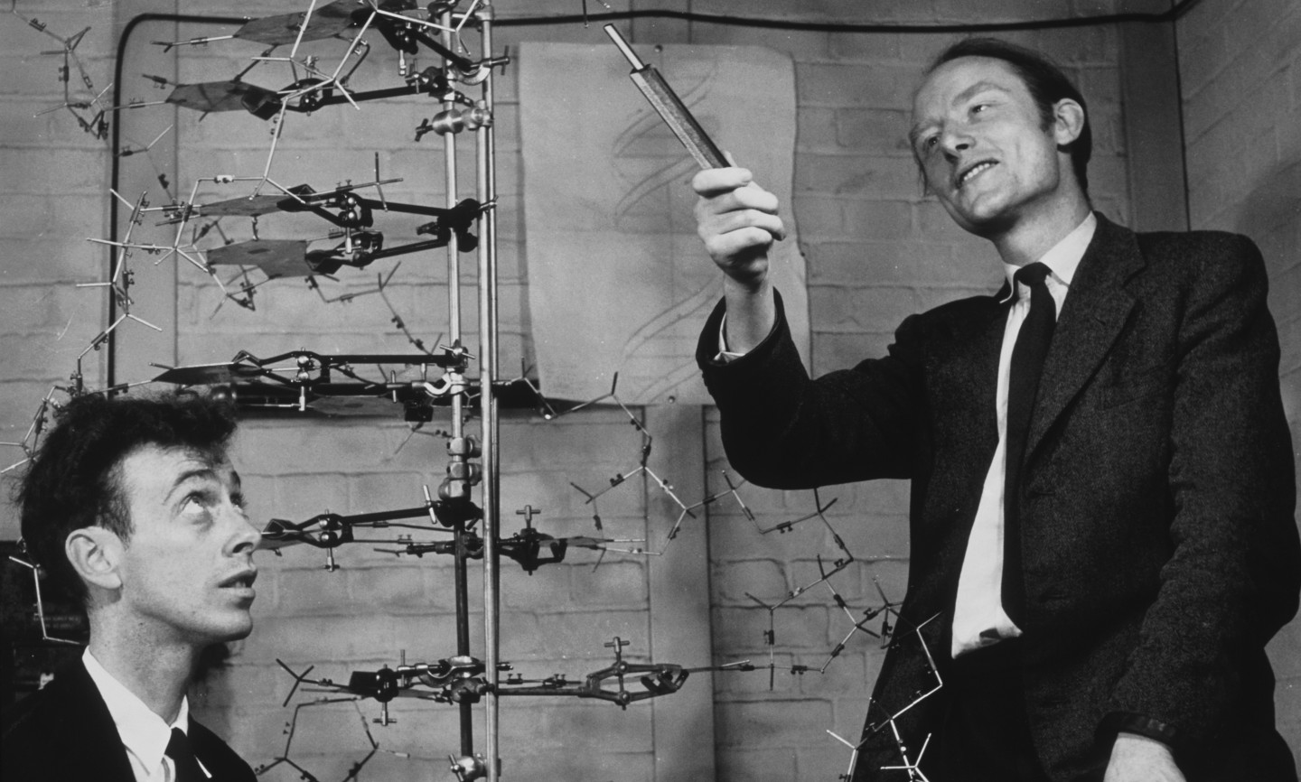
1). In 1953, two scientists announced their discover of Deoxyribonucleic Acid. What is this more commonly known as?
DNA!
Discovered by Watson and Crick in 1953.
Which female scientist was also a key part of this discovery but is often forgotten?

Slide 20
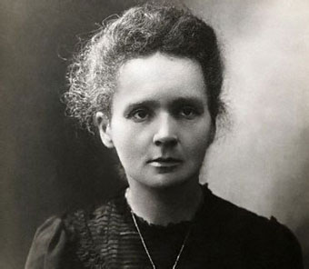
2). What is the name of the female scientist who discovered the radioactive element Radium, and won 2 Nobel Prizes for her work?
Marie Curie
The Marie Curie charity provides care and support for people living with any terminal illness, and their families.

Slide 21
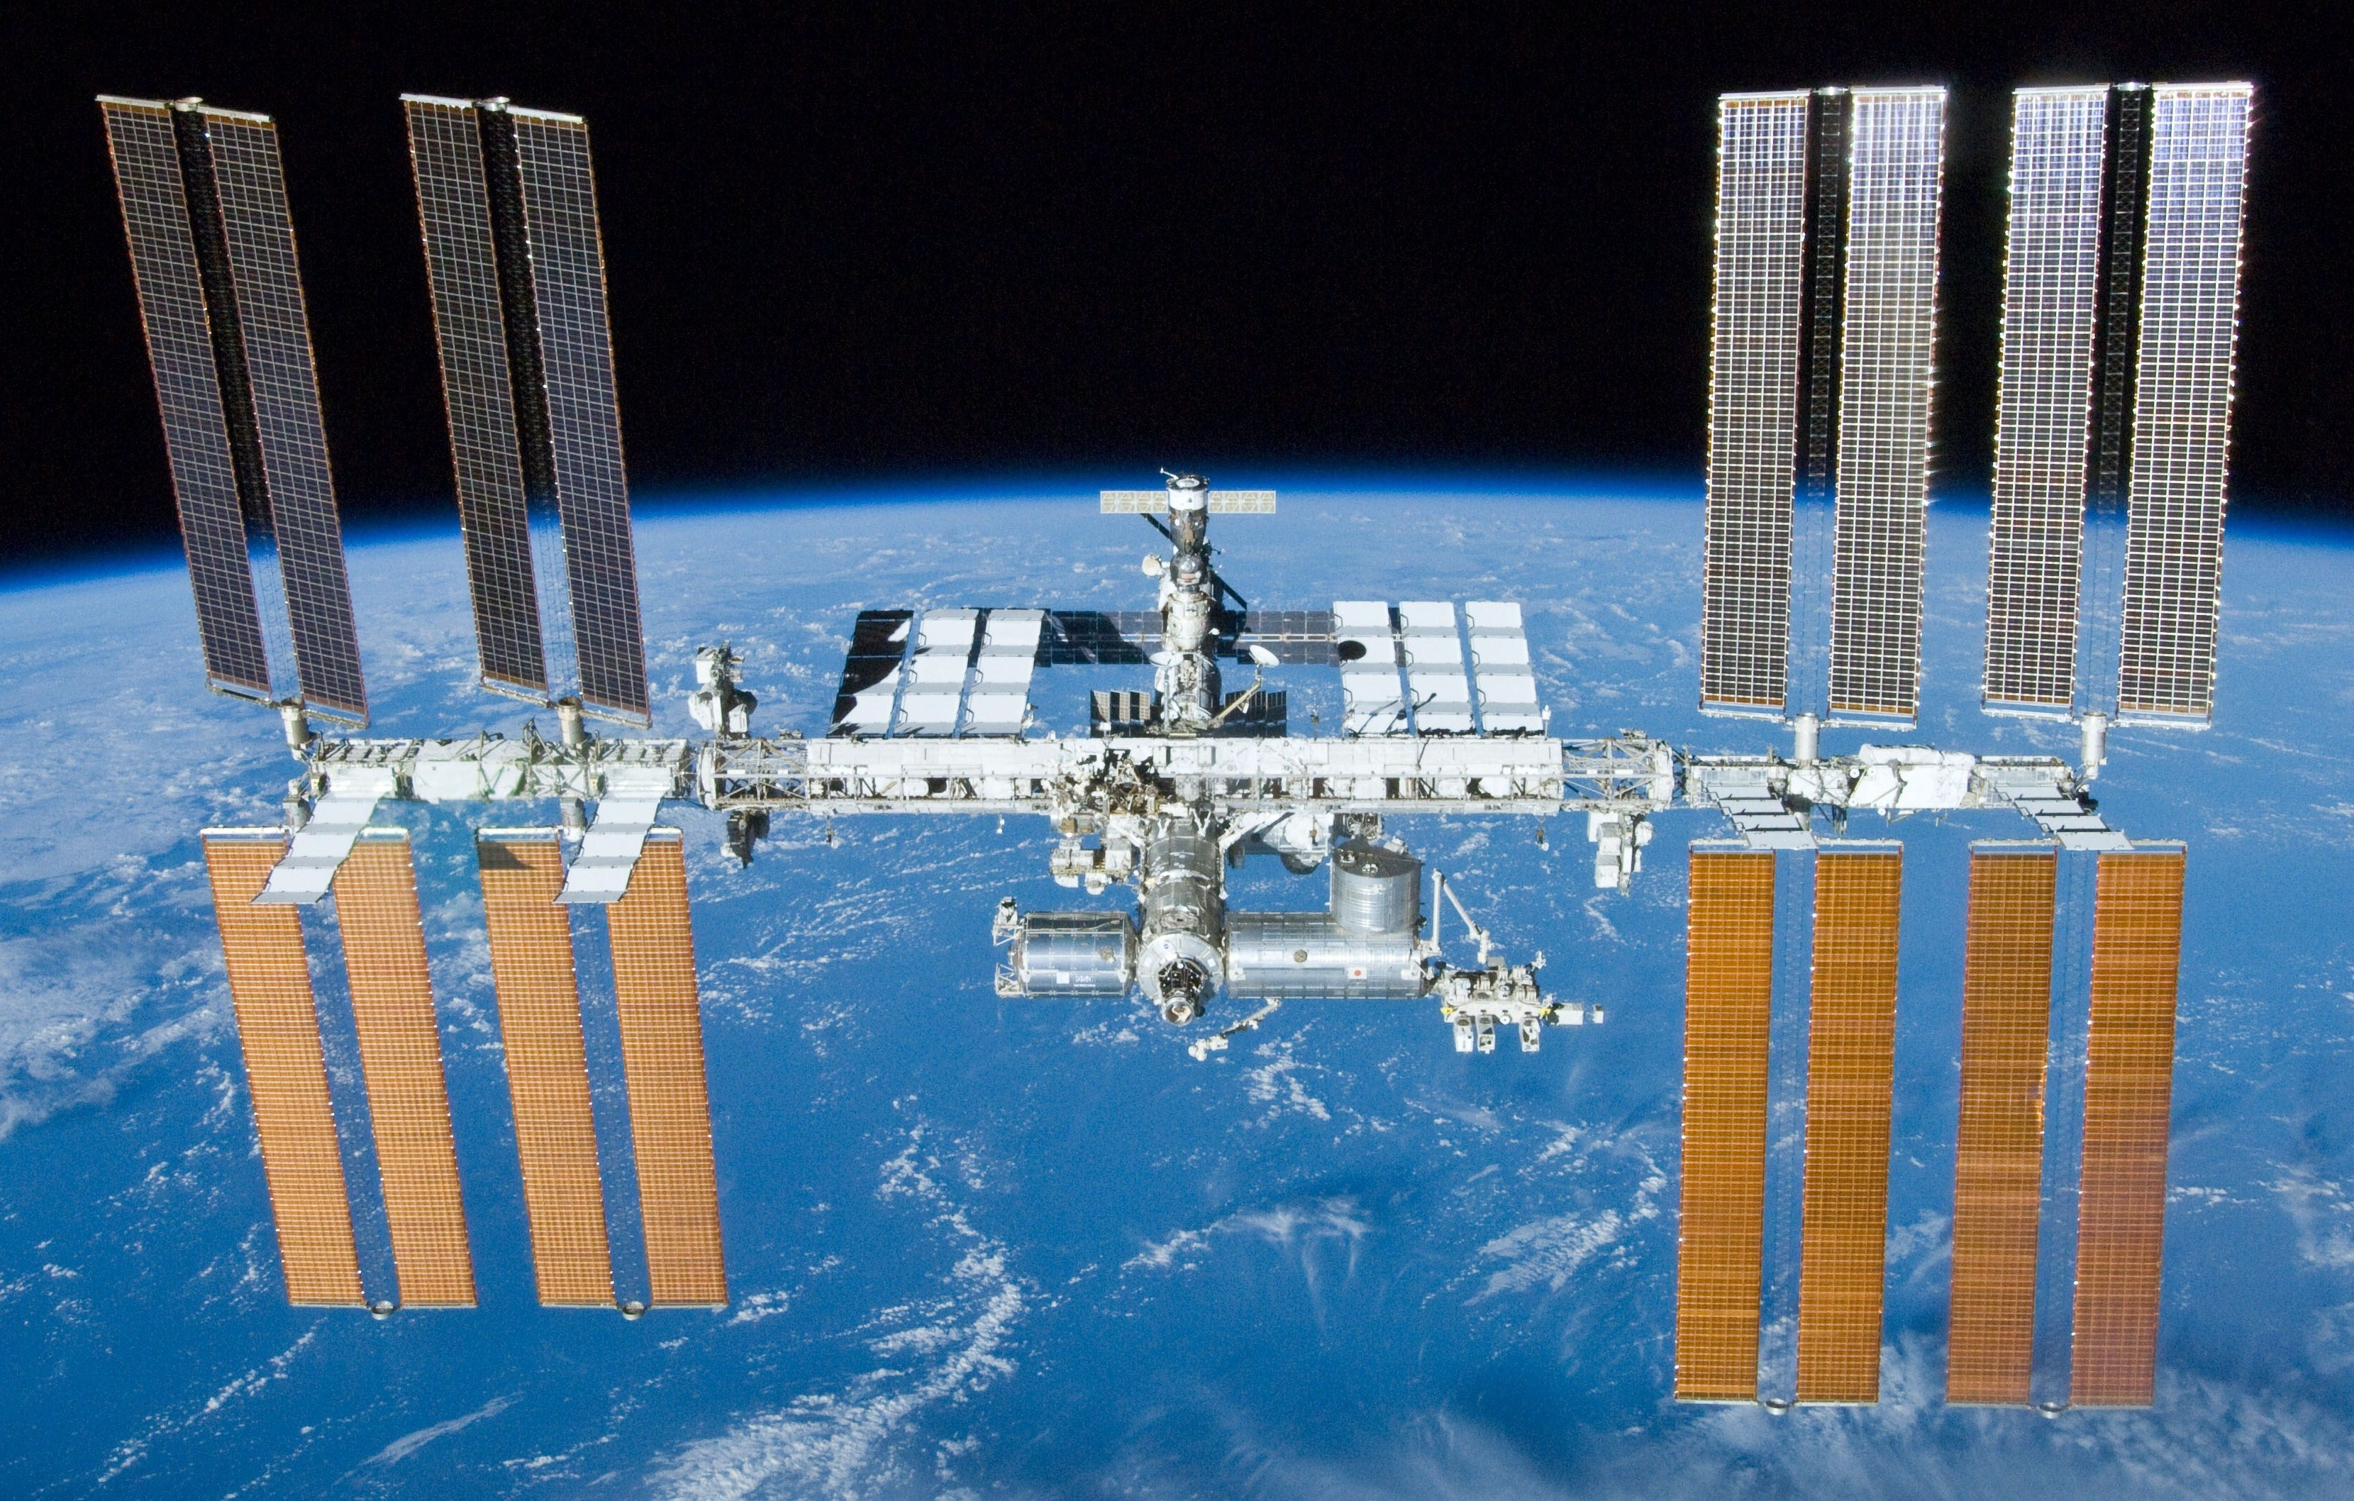
3). Tim Peake is almost halfway through his stay in Space, where he’s conducting lots of science experiments.
Where is he living during his mission?
The International Space Station
It orbits the Earth at around 17,000 mph, and completes 15 orbits a day!

Slide 22
4). Which virus is spread between people by the Aedes species of mosquito?
It has been linked to causing brain defects in babies born to infected mothers.
The Zika Virus
The outbreak began in April 2015 in Brazil, and has spread to other countries in South America, Central America, Mexico, and the Caribbean.

Slide 23
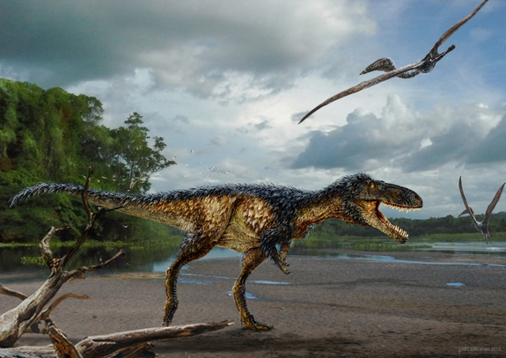
5). Scientists have recently discovered a new species of dinosaur, the Timurlengia euotica, which was about the size of a horse.
They believe this is the cousin of which famous dinosaur?
The T-rex!
The Timurlengia euotica lived during the Cretaceous, about 90 million years ago. It may not have been large, but it had a surprisingly developed brain.

